Slide 1
Lecture 7 K Means Clustering
Abrar Hasan
Lecturer
Dept. of Software Engineering

Slide 2
1
Clustering
<
T
1
>

Slide 3
Clustering
<
T
1
>
Clustering: the process of grouping a set of objects into classes of similar objects
Documents within a cluster should be similar.
Documents from different clusters should be dissimilar.

Slide 4
Clustering
<
T
1
>
Clustering: the process of grouping a set of objects into classes of similar objects
Documents within a cluster should be similar.
Documents from different clusters should be dissimilar.
The commonest form of unsupervised learning
Unsupervised learning = learning from raw data, as opposed to supervised data where a classification of examples is given
A common and important task that finds many applications in IR and other places

Slide 5
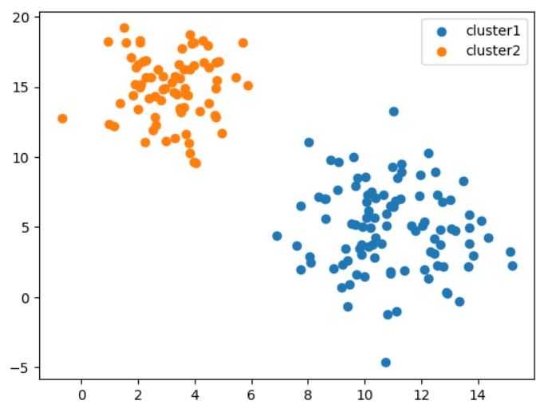
Clustering
<
T
1
>

Slide 6
Clustering
<
T
1
>
Class 2
Class 1

Slide 7
Clustering
<
T
1
>
Class 2
Centroid
Class 1

Slide 8



Clustering
<
T
1
>
Example of Clustering:
In real life when a company opens a store, they finds out which location would be the best location for their store.
Ever Wondered how it is done?

Slide 9
Clustering
<
T
1
>
Lets give you an idea.
At first,
The company collects the dataset of address (latitude and longitude) of the potential customers.

Slide 10
Clustering
<
T
1
>
Latitude(x) | longitude(y)
20.201 | 49.81513
25.72864 | 50.11764
23.8191 | 47.39496
18.69347 | 44.06723
17.98995 | 52.33613
22.81407 | 56.47059
14.37186 | 48.30252
14.37186 | 52.84034
16.68341 | 56.16806
51.65829 | 20.47059
44.52261 | 20.97479
48.34171 | 16.94118
43.51759 | 16.13446
53.16582 | 17.04202
54.87437 | 24.60504
48.34171 | 25.10924
56.38191 | 20.7731
50.85427 | 13.61345
57.18593 | 15.32773
The data set looks like this.
Looks scary, right?
Lets make it beautiful

Slide 11
Clustering
<
T
1
>

Slide 12
Clustering
<
T
1
>

Slide 13

Clustering
<
T
1
>
Is it beneficial?
Store Location

Slide 14

Clustering
<
T
1
>
So the company actually makes clusters

Slide 15

Clustering
<
T
1
>
Store Location 1
So the company actually makes clusters
Store Location 2

Slide 16
Clustering
<
T
1
>
Now the question arises:
So what should be the store location (latitude and longitude)?
Or how the clustering would be done?

Slide 17
2
K-Means
<
T
1
>

Slide 18

K Means
<
T
1
>
Remember Euclidian distance?
$\sqrt{\left(x1−x2\right)2+\left(y1−y2\right)2}$
= $\sqrt{\left(2−4\right)2+\left(4−5\right)2}$

Slide 19
K Means
<
T
1
>
Steps of K means:
STEP 1 : First know, what is the value of K?
(How many cluster you want to make)

Slide 20
K Means
<
T
1
>
Latitude(x) | longitude(y)
20.201 | 49.81513
25.72864 | 50.11764
23.8191 | 47.39496
18.69347 | 44.06723
17.98995 | 52.33613
22.81407 | 56.47059
14.37186 | 48.30252
14.37186 | 52.84034
16.68341 | 56.16806
51.65829 | 20.47059
44.52261 | 20.97479
48.34171 | 16.94118
43.51759 | 16.13446
53.16582 | 17.04202
54.87437 | 24.60504
48.34171 | 25.10924
56.38191 | 20.7731
50.85427 | 13.61345
57.18593 | 15.32773
Steps of K means:
STEP 2: Lets suppose K= 2. And you have a dataset

Slide 21
K Means
<
T
1
>
Latitude(x) | longitude(y)
20.201 | 49.81513
25.72864 | 50.11764
23.8191 | 47.39496
18.69347 | 44.06723
17.98995 | 52.33613
22.81407 | 56.47059
14.37186 | 48.30252
14.37186 | 52.84034
16.68341 | 56.16806
51.65829 | 20.47059
44.52261 | 20.97479
48.34171 | 16.94118
43.51759 | 16.13446
53.16582 | 17.04202
54.87437 | 24.60504
48.34171 | 25.10924
56.38191 | 20.7731
50.85427 | 13.61345
57.18593 | 15.32773
Steps of K means:
As K is 2, first two value would be the centroid of two clusters, Initially.
So centroid of cluster 1 = (20.201, 49.81)
So centroid of cluster 2 = (25.72864, 50.11764)
)

Slide 22
K Means
<
T
1
>
Latitude(x) | longitude(y)
20.201 | 49.81513
25.72864 | 50.11764
23.8191 | 47.39496
18.69347 | 44.06723
17.98995 | 52.33613
22.81407 | 56.47059
14.37186 | 48.30252
14.37186 | 52.84034
16.68341 | 56.16806
51.65829 | 20.47059
44.52261 | 20.97479
48.34171 | 16.94118
43.51759 | 16.13446
53.16582 | 17.04202
54.87437 | 24.60504
48.34171 | 25.10924
56.38191 | 20.7731
50.85427 | 13.61345
57.18593 | 15.32773

Slide 23
K Means
<
T
1
>
Latitude(x) | longitude(y)
20.201 | 49.81513
25.72864 | 50.11764
23.8191 | 47.39496
18.69347 | 44.06723
17.98995 | 52.33613
22.81407 | 56.47059
14.37186 | 48.30252
14.37186 | 52.84034
16.68341 | 56.16806
51.65829 | 20.47059
44.52261 | 20.97479
48.34171 | 16.94118
43.51759 | 16.13446
53.16582 | 17.04202
54.87437 | 24.60504
48.34171 | 25.10924
56.38191 | 20.7731
50.85427 | 13.61345
57.18593 | 15.32773
If K = 3 then we would select first 3 values
So centroid of cluster 1 = (20.201, 49.81)
So centroid of cluster 2 = (25.72864, 50.11764)
So centroid of cluster 3 = (23.8191, 47.3949)

Slide 24
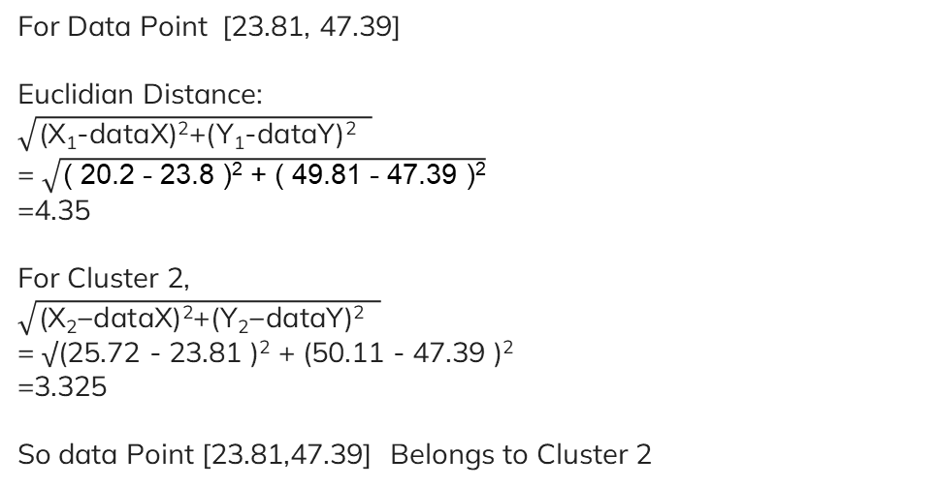
K Means
<
T
1
>
Latitude(x) | longitude(y)
20.201 | 49.81513
25.72864 | 50.11764
23.8191 | 47.39496
18.69347 | 44.06723
17.98995 | 52.33613
22.81407 | 56.47059
14.37186 | 48.30252
14.37186 | 52.84034
16.68341 | 56.16806
51.65829 | 20.47059
44.52261 | 20.97479
48.34171 | 16.94118
43.51759 | 16.13446
53.16582 | 17.04202
54.87437 | 24.60504
48.34171 | 25.10924
56.38191 | 20.7731
50.85427 | 13.61345
57.18593 | 15.32773
STEP 3 : Handling data points
For Data Point [23.81, 47.39]
Euclidian Distance:
$$\sqrt{\text{(}\text{X}\text{1}\text{-}\text{dataX}\text{)2+(}\text{Y}\text{1}\text{-}\text{dataY}\text{)2 }}$$
= $\sqrt{\text{( 20.2 - 23.8 )}\text{2}\text{ + ( 49.81 - 47.39 )}\text{2}}$
=4.35
For Cluster 2,
$$\sqrt{\text{(}\text{X}\text{2}\text{−}\text{dataX}\text{)2+(}\text{Y}\text{2}\text{−}\text{dataY}\text{)2 }}$$
= √(25.72 - 23.81 )² + (50.11 - 47.39 )²
=3.325
So data Point [23.81,47.39] Belongs to Cluster 2

Slide 25
K Means
<
T
1
>
Latitude(x) | longitude(y)
20.201 | 49.81513
25.72864 | 50.11764
23.8191 | 47.39496
18.69347 | 44.06723
17.98995 | 52.33613
22.81407 | 56.47059
14.37186 | 48.30252
14.37186 | 52.84034
16.68341 | 56.16806
51.65829 | 20.47059
44.52261 | 20.97479
48.34171 | 16.94118
43.51759 | 16.13446
53.16582 | 17.04202
54.87437 | 24.60504
48.34171 | 25.10924
56.38191 | 20.7731
50.85427 | 13.61345
57.18593 | 15.32773

Slide 26
K Means
<
T
1
>
Latitude(x) | longitude(y)
20.201 | 49.81513
25.72864 | 50.11764
23.8191 | 47.39496
18.69347 | 44.06723
17.98995 | 52.33613
22.81407 | 56.47059
14.37186 | 48.30252
14.37186 | 52.84034
16.68341 | 56.16806
51.65829 | 20.47059
44.52261 | 20.97479
48.34171 | 16.94118
43.51759 | 16.13446
53.16582 | 17.04202
54.87437 | 24.60504
48.34171 | 25.10924
56.38191 | 20.7731
50.85427 | 13.61345
57.18593 | 15.32773

Slide 27
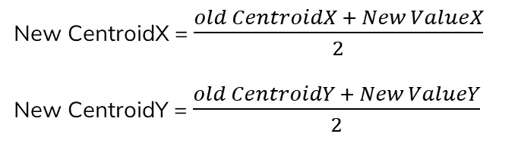
K Means
<
T
1
>
STEP 3 : Update Centroid
As the new data point belongs to cluster 2
We have to update the centroid of cluster 2
New CentroidX = $\frac{old CentroidX + New ValueX}{2}$
New CentroidY = $\frac{old CentroidY + New ValueY}{2}$

Slide 28
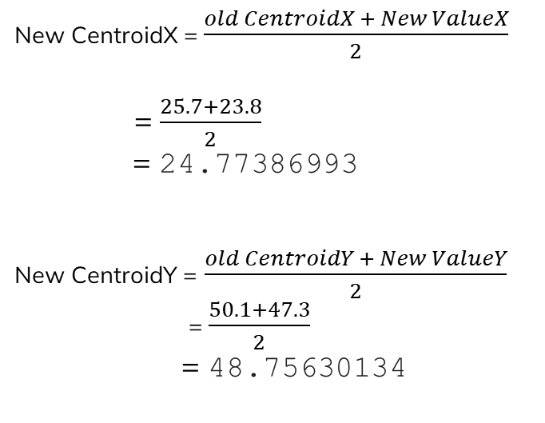
K Means
<
T
1
>
STEP 3 : Update Centroid
New CentroidX = $\frac{old CentroidX + New ValueX}{2}$
= $\frac{25.7+23.8}{2}$
= 24.77386993
New CentroidY = $\frac{old CentroidY + New ValueY}{2}$
= $\frac{50.1+47.3}{2}$
= 48.75630134
Centroid

Slide 29
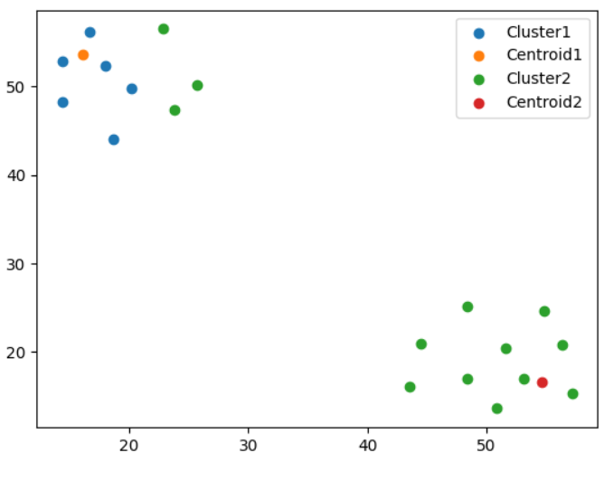
K Means
<
T
1
>

Slide 30
K Means
<
T
1
>
FIND OPTIMUM K VALUE

Slide 31
K Means
<
T
1
>
Calculating total distance of the cluster

Slide 32
K Means
<
T
1
>
Calculating total distance of the cluster 1 and Cluster 2
Total Distance =
Calculate the Euclidian distance from the centroid to all of the points if the cluster

Slide 33
K Means
<
T
1
>
Now consider K = 3
And you get 3 Clusters.
So three centroid.
Calculate total error.
Do this for K= 1,2,3…….

Slide 34
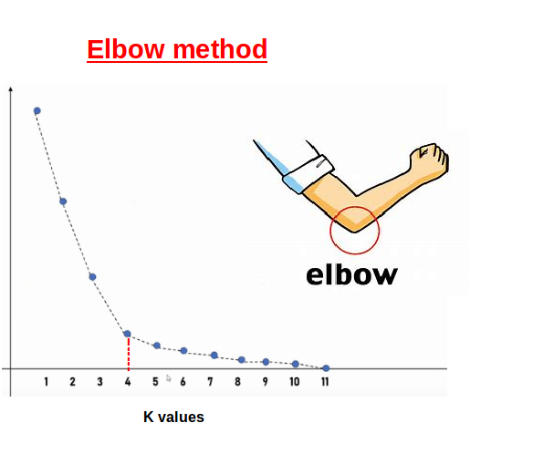
K Means
<
T
1
>
Now Plot this Total error vs K into a graph
Total error

Slide 35
Thank You

